Slide 1

Nonprofit Dashboards
September 26, 2023
Webinar Sponsor:

Slide 2

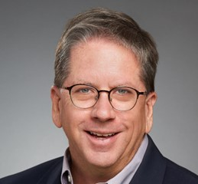
Enter your burning questions in the Chat, monitored by NFC moderators, to have them answered during our interactive Q&A sessions.
Wade Rogers
NFC Moderator
Mark Hager
NFC Moderator

Slide 3

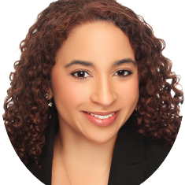
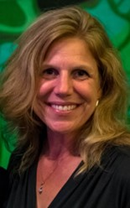
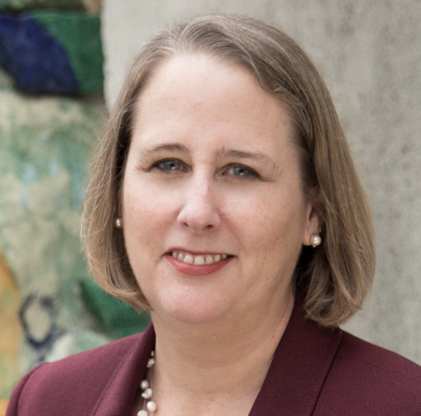
Today’s Presenters
HILDA POLANCO Market Managing Partner BDO | DANA BRITTO Consultant to Nonprofits & Foundations Moderator at Nonprofit Financial Commons | DAWN BENTLEY Executive Director Minnesota Fringe Festival | KIM ONDRECK CARIM Deputy Director, Finance and Administration Oakland Museum of California

Slide 4
Poll: What Is Your Organization’s Expense Budget?
1 | Below $250K
2 | Between $250K and $1M
3 | Between $1M and $5M
4 | More than $5M

Slide 5
Poll: What is your organization’s mission area?
1 | Animals & Environment
2 | Arts & Culture
3 | Advocacy & Organizing
4 | Capacity Building & Leadership Development
5 | Community Development & Workforce
6 | Healthcare & Aging
7 | Housing & Shelter
8 | Social Services
9 | Education & Youth
10 | Self-Help, Peer Support, Associational
11 | Other (in the chat)
Notes:
Ask participants to add “other” to chat
PRODUCER: Change chat settings for participants

Slide 6
Poll: Do you use a Dashboard?
1 | Yes, and it helps us make decisions
2 | Yes, but we do not update or review it regularly
3 | Not yet, but we are planning to or in development
4 | No
Notes:
Ask participants to add “other” to chat
PRODUCER: Change chat settings for participants

Slide 7
Poll: Who do you share your dashboard with?
1 | Executive Leadership
2 | Management team or Budget Owners
3 | Board
4 | Other External Stakeholders
Notes:
Ask participants to add “other” to chat
PRODUCER: Change chat settings for participants

Slide 8
Today’s Agenda
Dashboards and Understanding Business Model
Key Performance Indicators
Types of Indicators
Team-based Financial Decision-Making
Q&A
Case Studies
Q&A
Resources & Wrap Up

Slide 9
Dashboards
Notes:
Effective dashboards:
Complement, rather than replace, other reports
Are presented in a user-friendly format:
Creates a “snapshot” of organization performance
Displays current status and trends
Clearly shows performance against defined targets
Highlights out-of-the-ordinary results
Include a manageable set of Key Performance Indicators (KPI’s)

Slide 10



Dashboards as a Performance Management Tool Can Help You:
Be strategic with time and resources by focusing on key performance indicators that need attention
Understand your organization’s performance to better course correct
Focus conversations with stakeholders to drive strategic decision-making

Slide 11




Dashboards Can Help You Understand Your
Business Model
 | What are the strategic priorities for your organization?
 | What types of revenue drive your business model? (e.g. contributed, earned income, government)
 | What are major cost categories to monitor? (e.g. personnel, facilities, supplies)
 | What aspects of program delivery are driving results? (e.g. enrollment levels, member/ subscriber/ customer engagement, process efficiencies)

Slide 12
Poll: Which revenue model is most critical to your organization’s success?
1 | Individual Donors
2 | Foundations
3 | Government
4 | Earned Revenue
5 | Membership
Notes:
PRODUCER: Launch Poll

Slide 13
Key Performance Indicators
Successful KPIs:
Represent measurable business model drivers
Reflect progress toward intended outcomes
Have consistently available data
Are actionable and drive decisions
A set of KPIs is not forever: Periodically Reassess

Slide 14
Types of Indicators
LEADING INDICATORS
(predict the future)
LAGGING INDICATORS (understand the past)
  Predict future conditions
  Define what actions are necessary to achieve your goals
  Dynamic but difficult to measure
  Assess the current state
  Triggered by an event that has already occurred
  Easy to measure, but difficult to change
Organizations need both indicators for the clearest KPI picture
Notes:
“lead” to successfully meeting overall business objectives, which is why they are called “leading”.

Slide 15
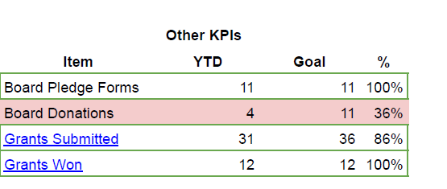
Leading & Lagging Indicators: Example
LEADING INDICATORS
Actions thought necessary to achieve goals – are they met?
LAGGING INDICATORS
Did actions have the desired effect? Informs future formula
Notes:
“lead” to successfully meeting overall business objectives, which is why they are called “leading”.

Slide 16
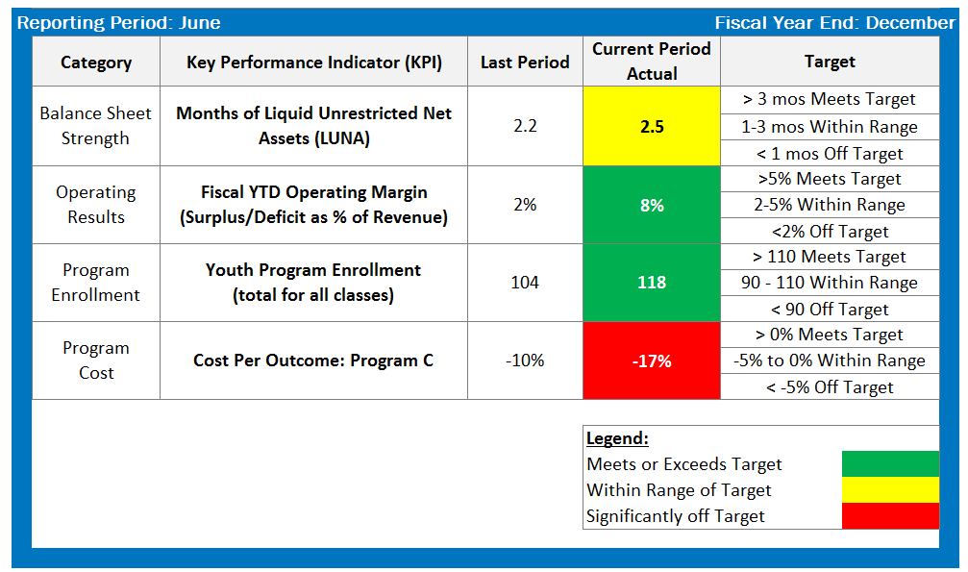
Dashboard Example
★ Tool available on strongnonprofits.org

Slide 17









Categories of Key Performance Indicators
Financial Health
Contract Management & Fundraising
Programs & Service Delivery
Human Capital
Marketing & Communications
Outreach & Advocacy
Information Technology
Risk Management & Governance
Facilities & Capital Projects
Equity

Slide 18
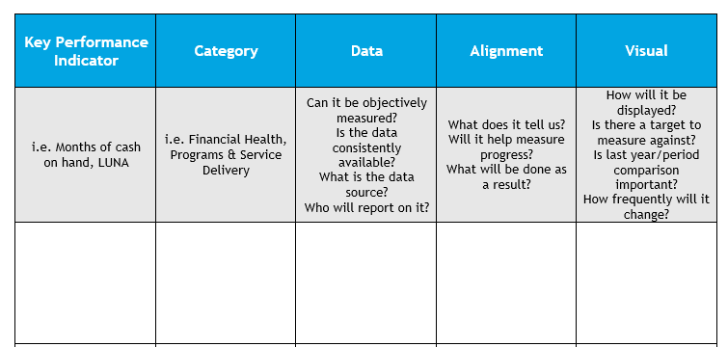
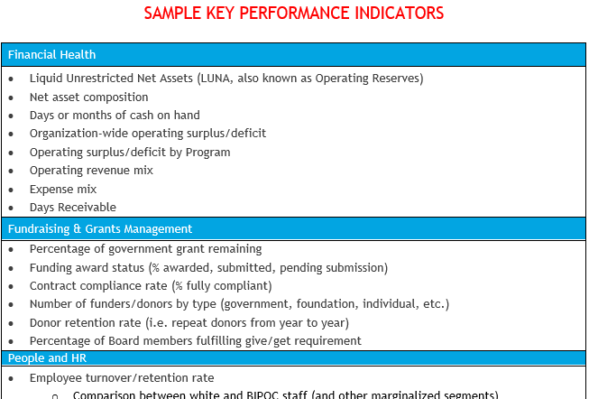
KPI “Cheat Sheet”

Slide 19
Stakeholders & Purpose
Identify your key stakeholders & purpose of the dashboard
QUESTIONS TO ASK:
What do these stakeholders need to know about the formulas of our business?
How will you engage your stakeholders to select critical metrics?
How can this group best use the dashboard
to test assumptions and drive action?
How can this group of stakeholders help drive continuous improvement?

Slide 20
Financial Management:
A Team Sport
Executive Director
Program & Department Managers
Human Resources Director
Lead Finance Staff Member
Development Director
Board Treasurer, Finance Committee
Notes:
The Finance Management team defined here are the Performance Management captains for the organization.
The Lead Finance staff member would coordinate the information from these –
Executive Director – provides an org-level update on current strategy and operations as well as new directions, new expenses or staff that are being considered.
HR director – apprises the team about workforce changes, and any changes in benefits that will affect the financial forecast.
Treasurer – provides the Board’s perspective especially as it relates to the resilience and sustainability of the organization.
Development Director – provides information regarding the revenue pipeline and any challenges or changes.
Program director + Program heads – provide information regarding program plans – any changes in programing as well as expenses (both personnel and other expenses).

Slide 21


Using Dashboards to Engage Teams
Foster empowerment and financial ownership
Enhance storytelling and transparency
    Get cross-functional input (across staff & Board) on KPIs
    Organize around a shared vision
      Reduce top-down thinking
    Clarify roles and responsibilities for desired outcomes
    Use dashboards to ensure robust interpretation of, and access to, performance data
    Make space for regular, open conversations to reveal the story the dashboard is telling

Slide 22

Using Dashboards to Test Assumptions
Making meaning from results
Understand where assumptions were accurate AND where they were not
    For Ex: data shows that increasing ticket prices actually did NOT increase ticket income
Identify and implement necessary changes and improvements
Going forward, keep the data to better assess current and future trends
    Use this to inform strategy development and refinement

Slide 23
Q&A

Slide 24
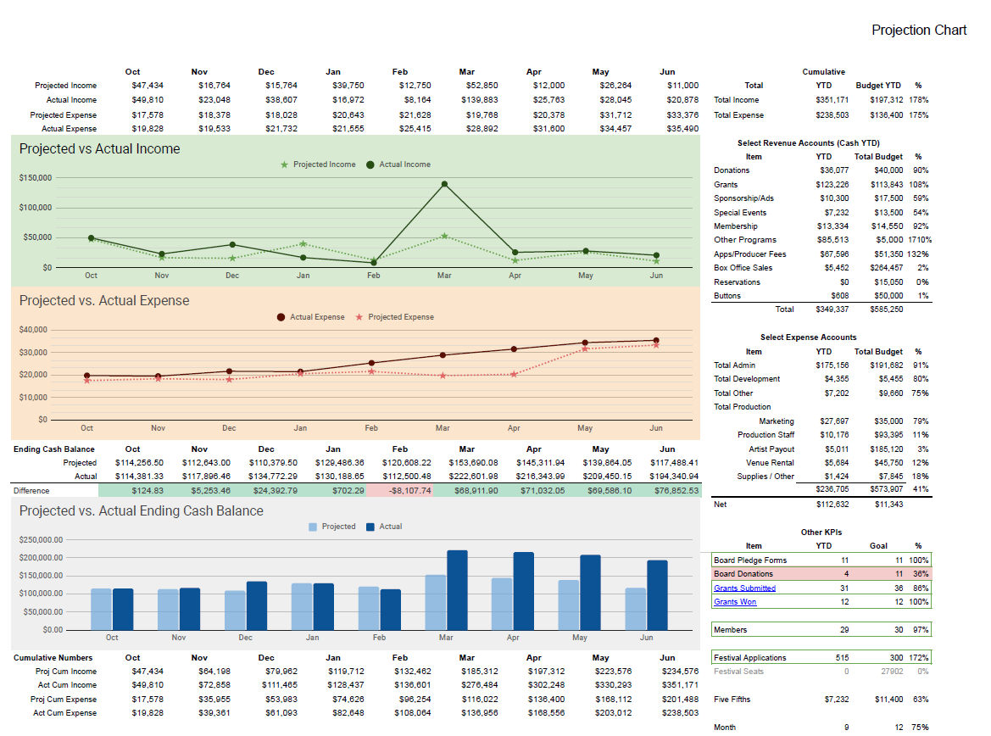

Slide 26
Q&A

Slide 27
Resources & Wrap Up

Slide 28
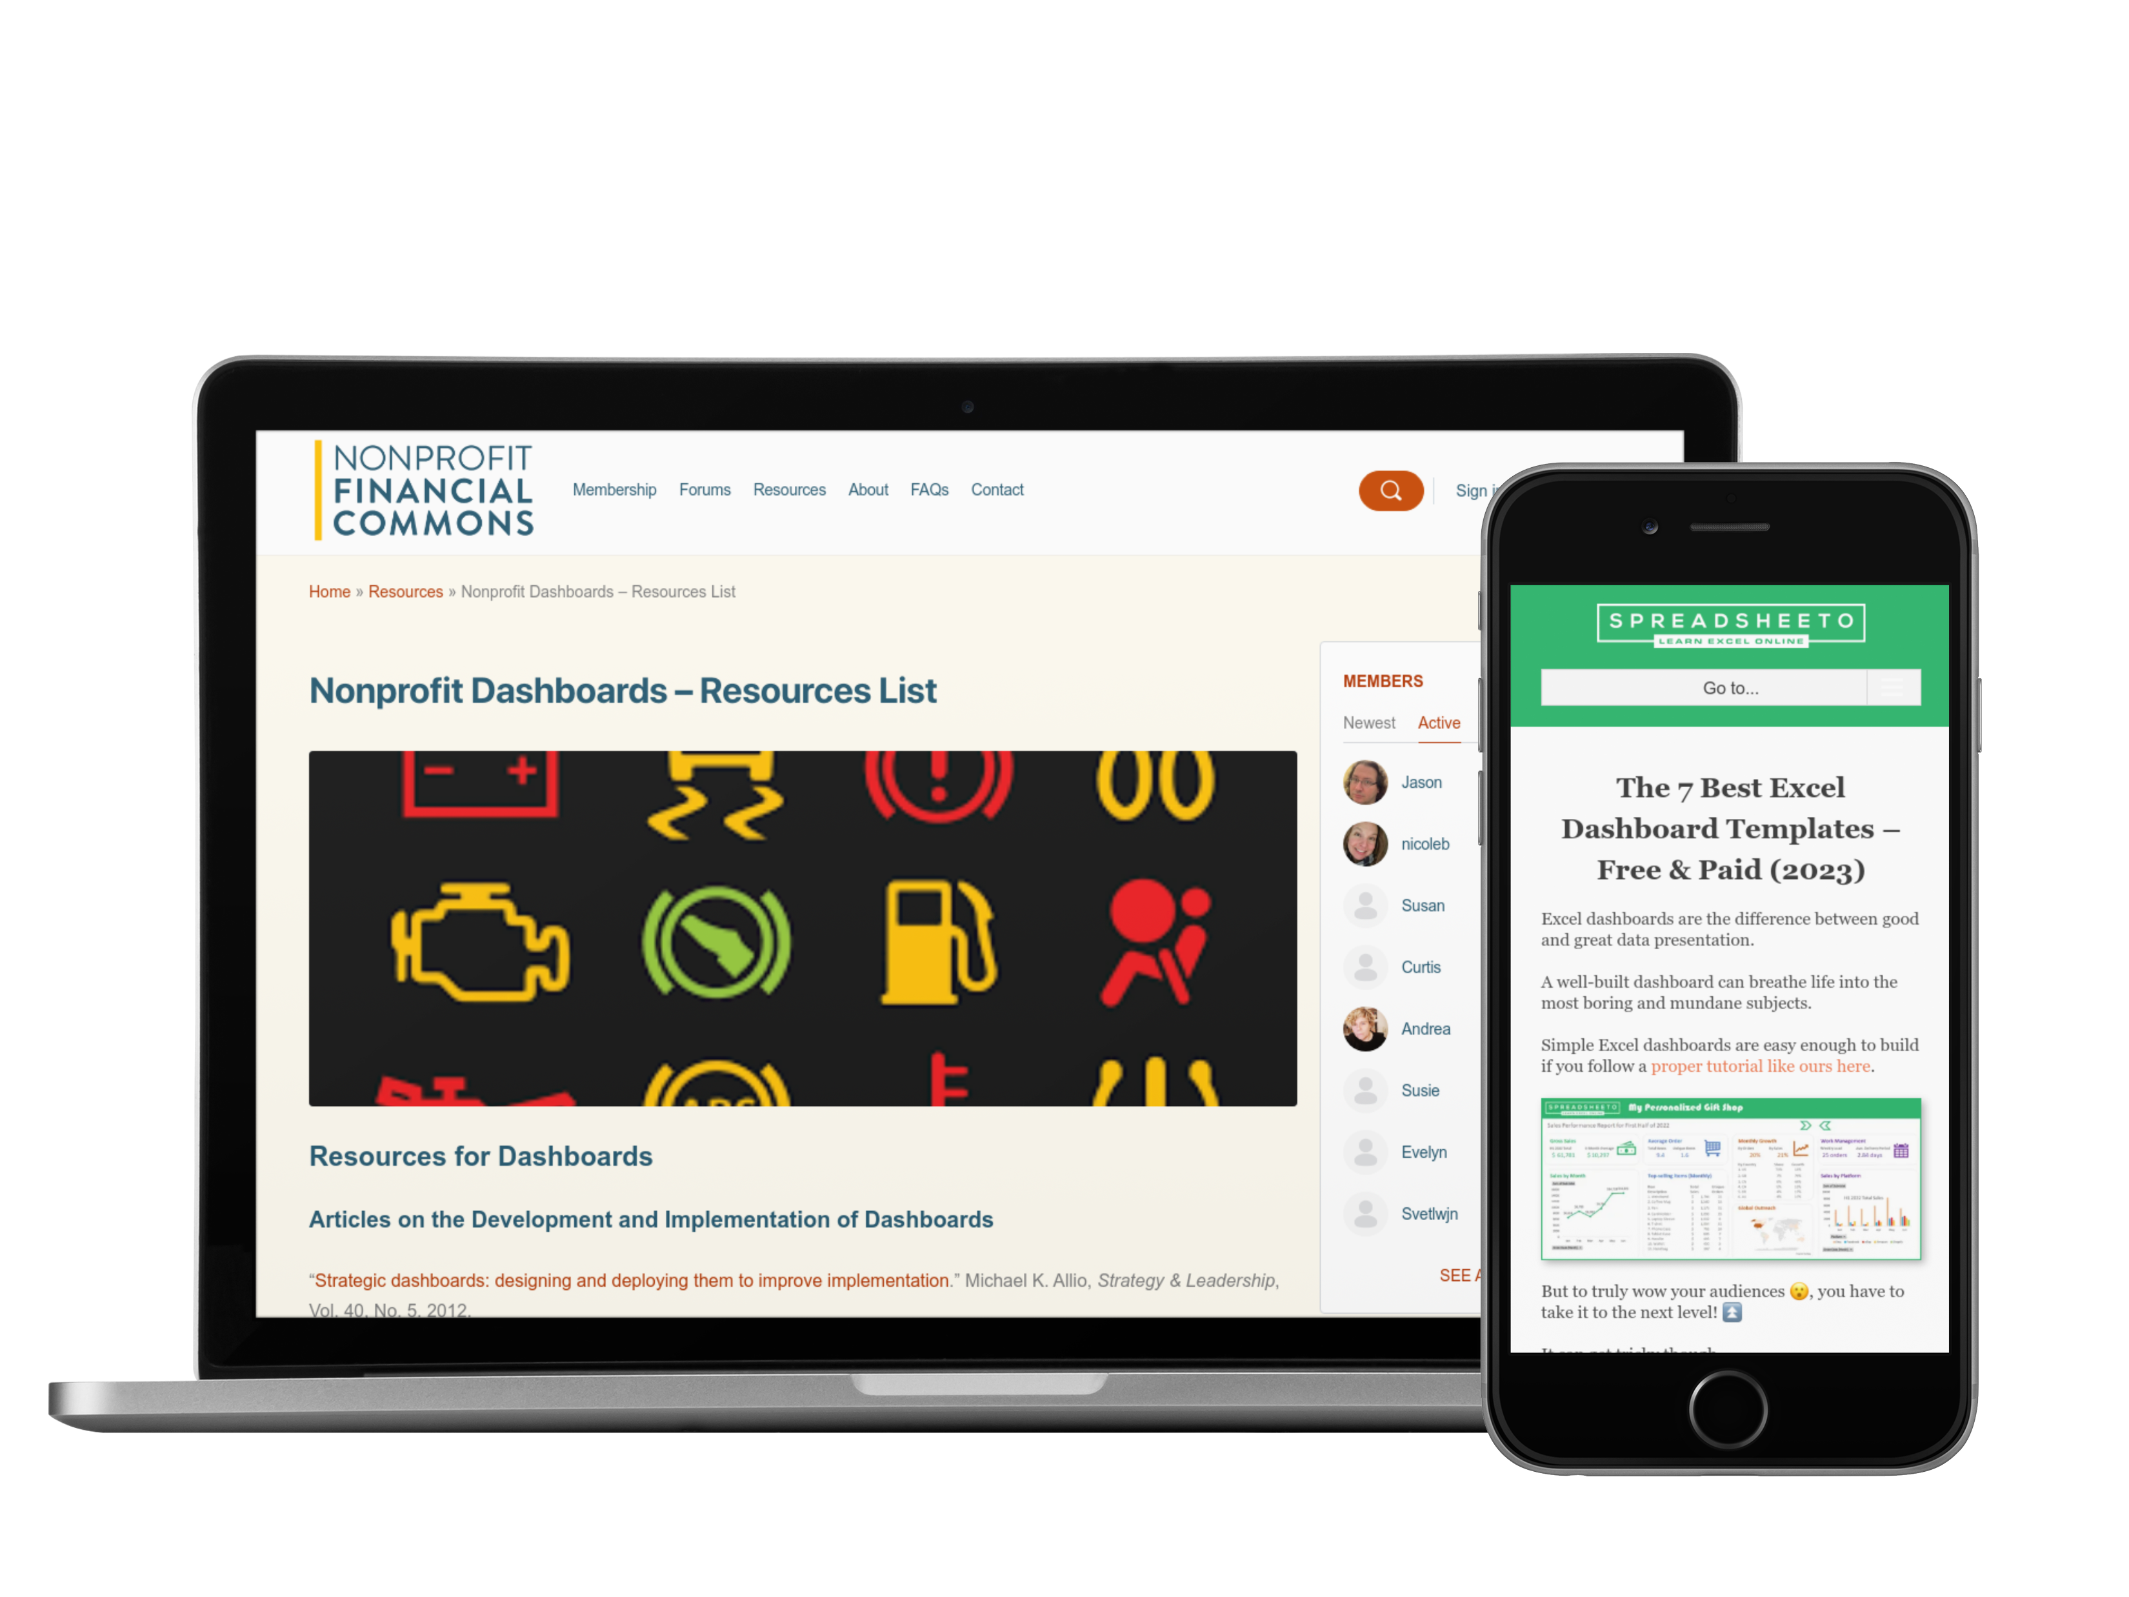

Slide 29

Stay Connected on the Forum
Notes:
Let’s keep the conversation going
A place to actively ask questions and receive answers
Kitchen table / stone soup
Share link to forum in the chat

Slide 30
What do you want to learn more about?
Add it to the chat!
Notes:
PRODUCER: Change chat settings to allow participants to use chat

