Slide 1
Nonprofit Business Models: Government Funding
June 20, 2023
Webinar Sponsor:

Slide 2
Enter your burning questions in the Chat, monitored by NFC moderators, to have them answered during our interactive Q&A sessions.
Wade Rogers
NFC Moderator
Mark Hager
NFC Moderator

Slide 3
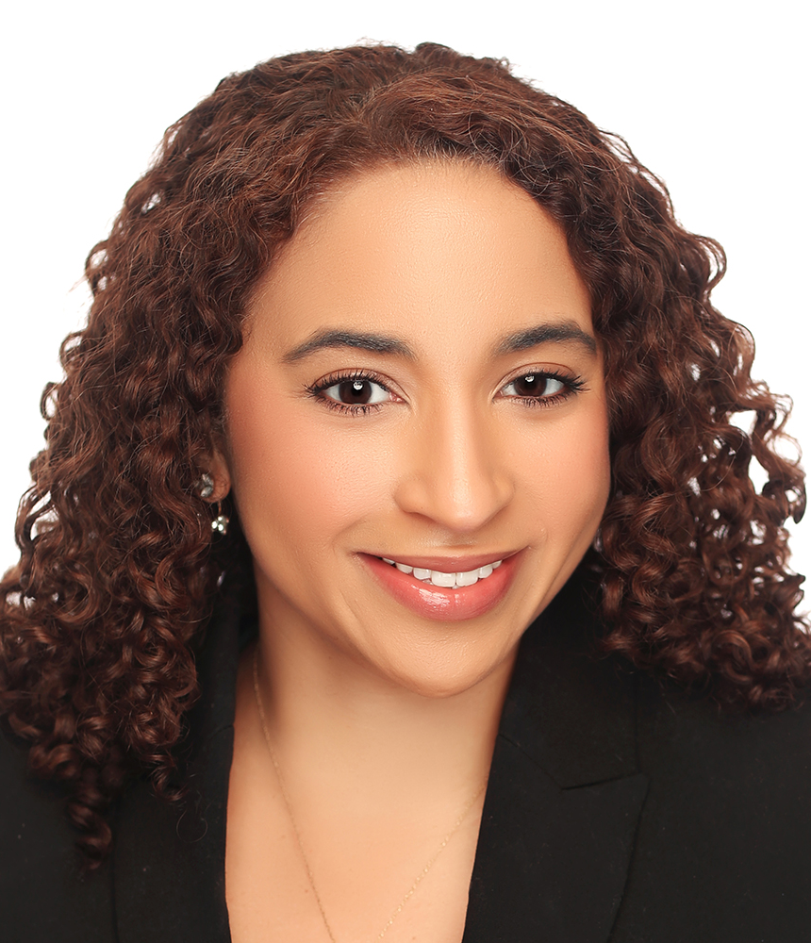
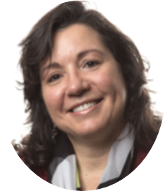
Today’s Presenters
DANA BRITTO
Consultant to Nonprofits & Foundations
Moderator at Nonprofit Financial Commons
HILDA POLANCO
Market Managing Partner
BDO
JOHN SUMMERS
Managing Director
BDO
Notes:
Panel Discussion Points: Level of embeddedness
Central: BM is based on the mission like arts, childcare, revenue is directly tied to mission-based service provided
Complimentary: Do something, but side business which is related, but not explicit goal, generates income
Unrelated:
Have one example in the panel for each category.
Central – arts
Complimentary – San Jose, workforce development org with employment org on the side
Unrelated – FEGS – social service agency with back office accounting shop

Slide 4
Poll: What Is Your Organization’s Expense Budget?
1 | Below $250K
2 | Between $250K and $1M
3 | Between $1M and $5M
4 | More than $5M

Slide 5
Poll: What is your organization’s mission area?
1 | Animals & Environment
2 | Arts & Culture
3 | Advocacy & Organizing
4 | Capacity Building & Leadership Development
5 | Community Development & Workforce
6 | Healthcare & Aging
7 | Housing & Shelter
8 | Social Services
9 | Education & Youth
10 | Self-Help, Peer Support, Associational
11 | Other (in the chat)
Notes:
Ask participants to add “other” to chat
PRODUCER: Change chat settings for participants

Slide 6
Poll: What percentage of your revenue comes from government sources (i.e., federal, state, or local)?
1 | 0 - 25%
2 | 26 – 50%
3 | 51 - 75%
4 | 76 - 100%

Slide 7
Today’s Agenda
Business Model Considerations
Current Research
Panel Conversation
Q&A
Resources & Wrap Up

Slide 8
5 Common Nonprofit Business Models
INDIVIDUAL DONOR
FOUNDATION (“INSTITUTIONAL”)
GOVERNMENT
FEE FOR SERVICE
MEMBERSHIP
Notes:
Shift to Hilda

Slide 9
5 Common Nonprofit Business Models
INDIVIDUAL DONOR
FOUNDATION (“INSTITUTIONAL”)
GOVERNMENT
EARNED REVENUE
MEMBERSHIP
Notes:
Shift to Hilda

Slide 10
The Nonprofit Economy

Slide 11
Business Model Considerations
Revenue Source
Risk
Leadership Capacity
Infrastructure Needs
Who’s paying and for what?
What are the common risks, sensitivities & challenges?
What leadership orientation is best suited?
What systems need be in place?

Slide 12
Business Model Considerations
GOVERNMENT
WHO PAYS
Federal
State, sometimes as passthrough of federal
Local, sometimes as passthrough of federal, state, or county
EXAMPLES
Community Action Agencies and other multi-service centers
Standalone programs in areas such as:
Legal services
Substance abuse
Domestic violence prevention
Youth services and adoptions
Senior services and housing
Notes:
FINE PRINT – ARPA – PASS THROUGH WARNING OF MINIMUM REQUIREMENTS

Slide 13
Business Model Considerations
GOVERNMENT
SENSITIVITIES, RISKS, & CHALLENGES
Very low or negative financial margins
High sensitivity to contracting processes
Political and policy changes which can eliminate or curtail funding
Generally a high level of restricted dollars
LEADERSHIP CAPACITIES
Good political instincts and healthy field networks that provide information early and often
Ability to mobilize stakeholders as constituents or advocates
INFRASTRUCTURE NEEDS
Strong data collection mechanisms
Strong compliance mechanisms and culture
Strong financial systems that can forecast cashflow-related problems

Slide 14
Govt. Contracts: A Predictable Formula
Highly restricted contracts
Limited coverage of full costs
Frequent delays in funding
Heavy admin requirements
Potential limits to large operating margins and cash availability
Notes:
No common formula – all orgs have their unique capital needs

Slide 15
Maximizing the Benefits of Government Funding
Benefits of government revenue could include:
Substantial sources of annual income
Potential for recurring multi-year funding
To help ensure and maximize these benefits:
Understand the costs/risks and plan accordingly
Submit invoices and reports as quickly and accurately as possible
When possible, negotiate and advocate for maximum coverage of indirect costs
Ensure sufficient capacity to raise unrestricted dollars

Slide 16
Financial Capital Supporting Liquidity
Liquid Unrestricted Net Assets (LUNA)
Liquidity (Working Capital)
Security (Maintaining Operations)
Source: BDO FMA
Notes:
No common formula – all orgs have their unique capital needs

Slide 17
Liquid Unrestricted Net Assets (LUNA)
Unrestricted Net Assets
Illiquid Net Assets
Liquid Unrestricted Net Assets
Our Unrestricted Net Worth
Unavailable Net Worth
Operating Reserves
Most commonly calculated by the average months of operating expenses which can be covered by LUNA
Source: BDO FMA

Slide 18
Poll: How Many Months of LUNA Should an Organization Have?
1 | Less than a month
2 | 1-3 months
3 | 3-6 months
4 | 6+ months

Slide 19
Liquidity Considerations

Slide 20
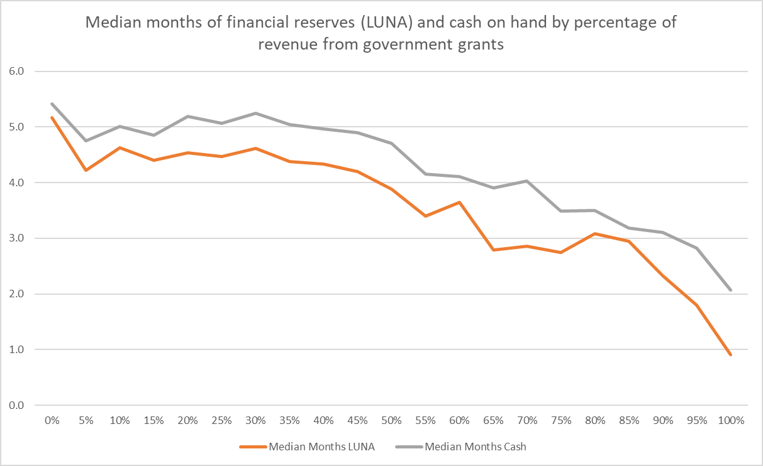
Source: GOVERNMENT-FUNDED NONPROFITS FACE SERIOUS OBSTACLES TO BUILDING FINANCIAL RESERVES AND WORKING CAPITAL, JOHN SUMMERS, MANAGING DIRECTOR, BDO NONPROFIT AND GRANTMAKER ADVISORY SERVICES

Slide 21
Q&A

Slide 22
Panelist Conversation

Slide 23
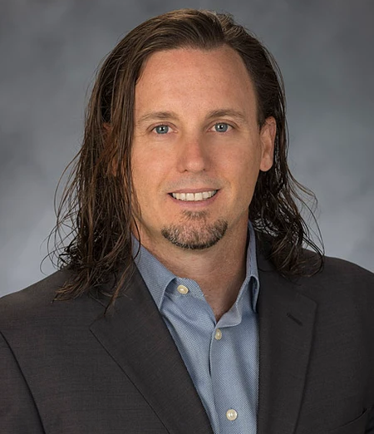
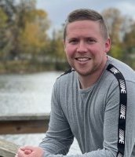
Today’s Panelists
ETHAN EVANS
Sacramento Self-Help Housing, California
COREY SMITH
Chief Financial Officer
KOOTASCA Community Action
Notes:
Panel Discussion Points: Level of embeddedness
Central: BM is based on the mission like arts, childcare, revenue is directly tied to mission-based service provided
Complimentary: Do something, but side business which is related, but not explicit goal, generates income
Unrelated:
Have one example in the panel for each category.
Central – arts
Complimentary – San Jose, workforce development org with employment org on the side
Unrelated – FEGS – social service agency with back office accounting shop

Slide 24
KOOITASCA Revenue Breakdown

Slide 25
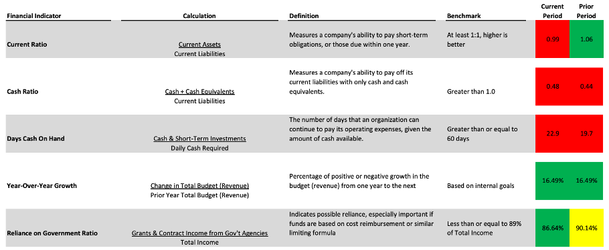
KOOTASCA Dashboard

Slide 26
Q&A

Slide 27
Resources & Wrap Up

Slide 28
Notes:
PRODUCER: Share Link - https://bit.ly/409L8Cx

Slide 29
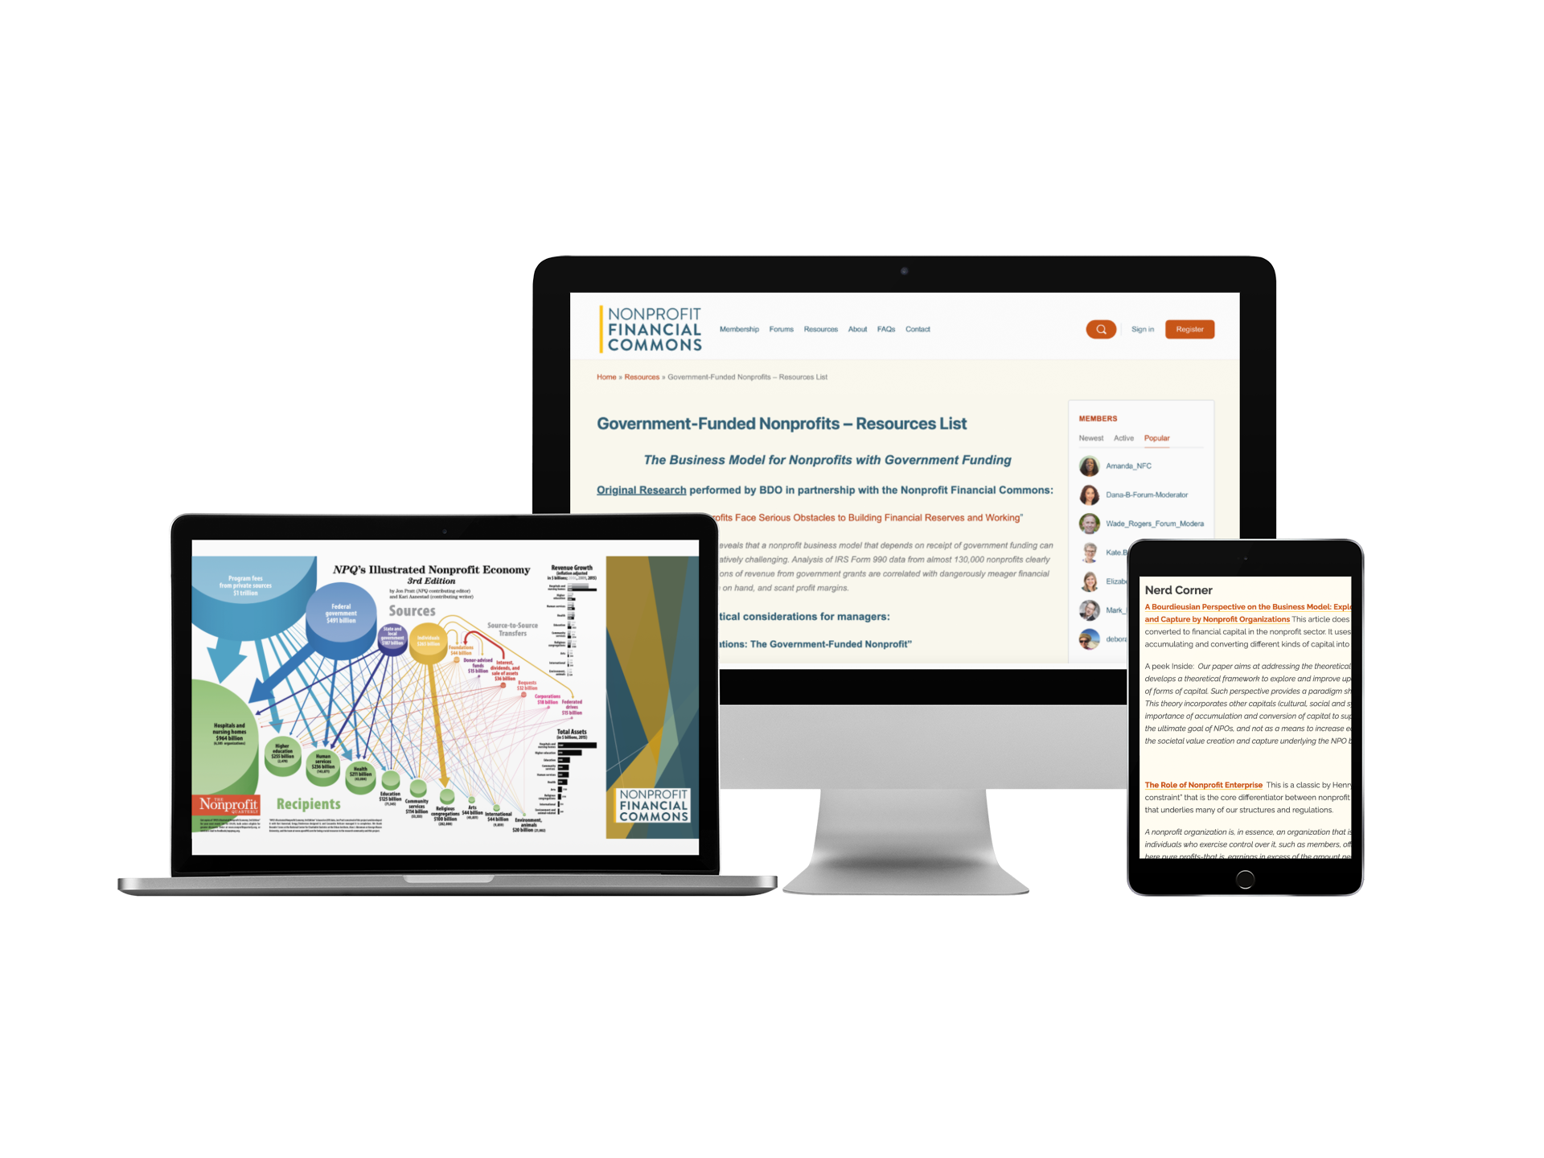

Slide 30
Stay Connected on the Forum
Notes:
Let’s keep the conversation going
A place to actively ask questions and receive answers
Kitchen table / stone soup
Share link to forum in the chat

Slide 31
What do you want to learn more about?
Add it to the chat!
Notes:
PRODUCER: Change chat settings to allow participants to use chat

