Slide 1
Nonprofit Business Models: Foundation Funding
July 18, 2023
Webinar Sponsor:

Slide 2
Enter your burning questions in the Chat, monitored by NFC moderators, to have them answered during our interactive Q&A sessions.
Wade Rogers
NFC Moderator
Mark Hager
NFC Moderator

Slide 3
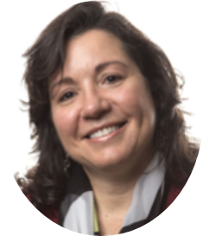
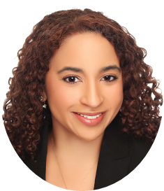
Today’s Presenters
HILDA POLANCO
Market Managing Partner
BDO
DANA BRITTO
Consultant to Nonprofits & Foundations
Moderator at Nonprofit Financial Commons

Slide 4
Poll: What Is Your Organization’s Expense Budget?
1 | Below $250K
2 | Between $250K and $1M
3 | Between $1M and $5M
4 | More than $5M

Slide 5
Poll: What is your organization’s mission area?
1 | Animals & Environment
2 | Arts & Culture
3 | Advocacy & Organizing
4 | Capacity Building & Leadership Development
5 | Community Development & Workforce
6 | Healthcare & Aging
7 | Housing & Shelter
8 | Social Services
9 | Education & Youth
10 | Self-Help, Peer Support, Associational
11 | Other (in the chat)
Notes:
Ask participants to add “other” to chat
PRODUCER: Change chat settings for participants

Slide 6
Poll: What role does foundation funding play at your organization?
1 | Covers general operating expenses
2 | Provides capacity building opportunities
3 | Seeds money for new projects or initiatives
4 | Funds programmatic activities and program delivery
5 | Fills budget gaps, planned or unplanned
6 | Supports facilities and capital improvements

Slide 7
Today’s Agenda
Perspectives from the Nonprofit News Sector
Q&A
The World of Foundations
Business Model Considerations
Q&A
Case Study: Block Club Chicago
Q&A
Resources & Wrap Up

Slide 8
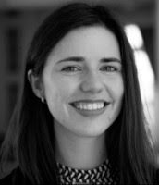
Perspective from the Nonprofit News Sector
EMILY ROSEMAN
Research Director & Editor
Institute for Nonprofit News
Notes:
Panel Discussion Points: Level of embeddedness
Central: BM is based on the mission like arts, childcare, revenue is directly tied to mission-based service provided
Complimentary: Do something, but side business which is related, but not explicit goal, generates income
Unrelated:
Have one example in the panel for each category.
Central – arts
Complimentary – San Jose, workforce development org with employment org on the side
Unrelated – FEGS – social service agency with back office accounting shop

Slide 10
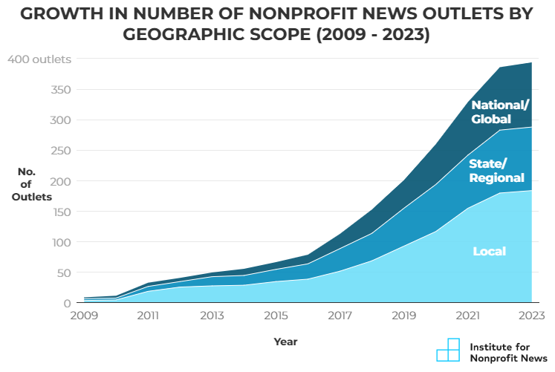
Source: The State of Nonprofit News, Institute for Nonprofit News, May 2023

Slide 11
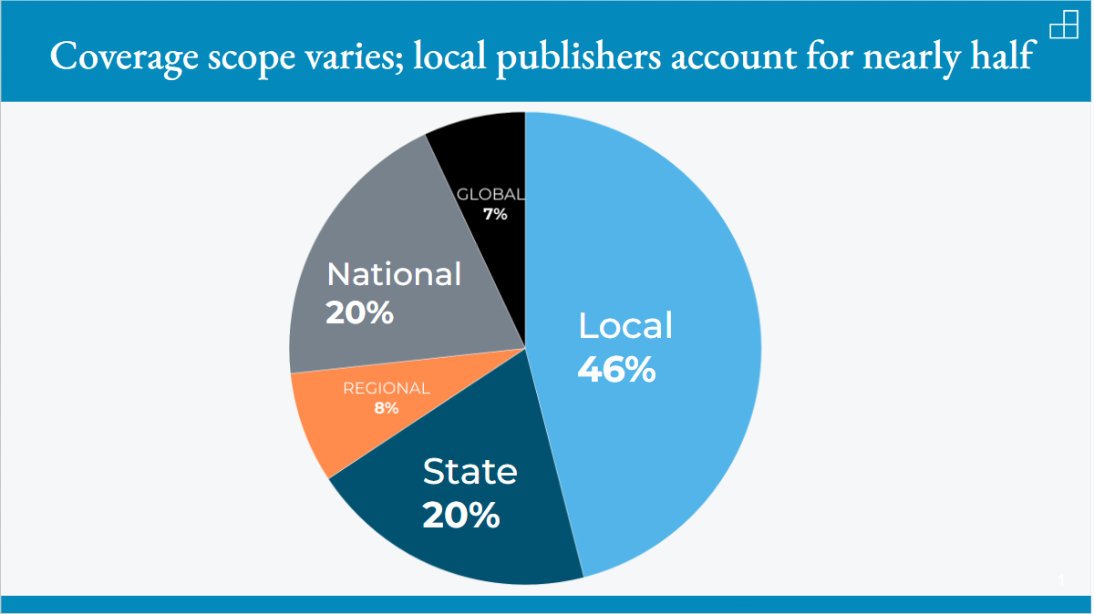
Source: The State of Nonprofit News, Institute for Nonprofit News, May 2023

Slide 12
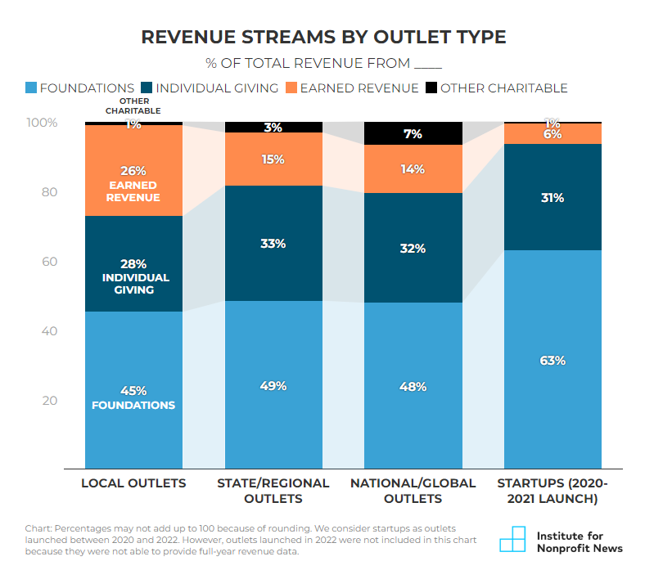
Source: The State of Nonprofit News, Institute for Nonprofit News, May 2023

Slide 13
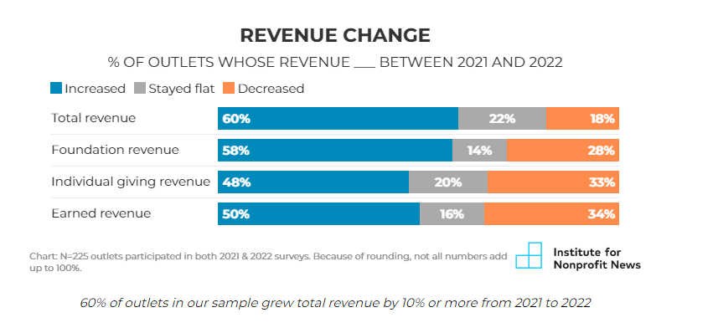
Source: The State of Nonprofit News, Institute for Nonprofit News, May 2023

Slide 14
Q&A

Slide 15
The World of Foundations

Slide 16
Types of Foundations
INDEPENDENT FOUNDATIONS
FAMILY FOUNDATIONS
CORPORATE FOUNDATIONS
Not governed by the benefactor, the benefactor’s family, or a corporation.
Usually funded by endowments from a single source such as an individual or group of individuals
Usually funded by an endowment from a family.
Family members of the donor(s) have a substantial role in the foundation’s governance
Created and financially supported by a corporation.
The foundation is created as a separate legal entity from the corporation, but with close ties to the corporation
INTERNATIONAL FOUNDATIONS
PRIVATE OPERATING FOUNDATIONS
Typically based outside the United States and make grants in their own countries and overseas.
Also refers to foundations in any country that primarily engage in cross-border giving
Private foundations that primarily operate their own charitable programs, although some also make grants.
Source: Council on Foundations, Foundation Basics

Slide 17
The Nonprofit Economy

Slide 18
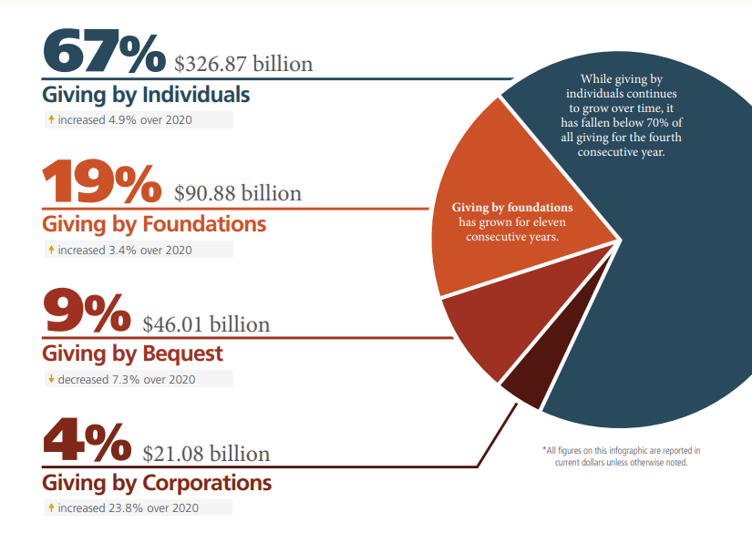

Slide 19
Creating Social Value
Accumulation of Social Capital
Accumulation of Cultural Capital
Accumulation of Symbolic Capital
Creation
Societal Value
Accumulation of Economic Capital

Slide 20
5 Common Nonprofit Business Models
INDIVIDUAL DONOR
FOUNDATION (“INSTITUTIONAL”)
GOVERNMENT
FEE FOR SERVICE
MEMBERSHIP
Notes:
Shift to Hilda

Slide 21
5 Common Nonprofit Business Models
INDIVIDUAL DONOR
FOUNDATION (“INSTITUTIONAL”)
GOVERNMENT
FEE FOR SERVICE
MEMBERSHIP
Notes:
Shift to Hilda

Slide 22
Business Model Considerations
Revenue Source
Risk
Leadership Capacity
Infrastructure Needs
Who’s paying and for what?
What are the common risks, sensitivities & challenges?
What leadership orientation is best suited?
What systems need be in place?

Slide 23
Business Model Considerations
FOUNDATION FUNDING
SENSITIVITIES, RISKS, & CHALLENGES
Changing funder priorities which may be unanticipated
Requires an array of funders to maintain funding security
LEADERSHIP CAPACITIES
Influential, persuasive, and well-informed. Able to effectively argue for programs
Capable of continuously updating maps of funding landscape
INFRASTRUCTURE NEEDS
Grants management systems which track all stages of the grants process and requirements
Internal capacity to survey funders and determine program fit

Slide 24
True Cost Project Research and Findings
>3/4 of US foundation giving is project-restricted *
2/3 of largest US foundations cap indirect costs at ≤20%
Notes:
[True Cost Project was a name used internally, it refers to the 2016-2018 collaboration of the founding five foundations that commissioned Bridgespan’s research.]
Bridgespan research (NCRP as cited on slide) found:
In the U.S., project grants represent over 75% of foundation giving; and globally nearly ALL government funding is project-restricted.
Most funders use a MAXIMUM RATE to compensate indirect costs, which almost always fall below what an organization actually needs.
At the time of the Bridgespan research (c. 2017), TWO-THIRDS of the largest foundations in the U.S. had an indirect cost policy of 20 percent or less;
MOST bilateral or multilateral funders operating internationally restrict indirect costs to between 5 and 8%.
Fixed rates ALSO exist because typically foundation staff don’t have the TIME or EXPERTISE to verify an actual rate for each individual grantee

Slide 25
Spectrum of Grant Approaches
Organizational Level
Program Level
Project Level
Line-Item Level
Enterprise
support
Flexible
program
support
Flexible
project
support
Cost-based
project
support
Funding grantees as institutions (including growth, infrastructure and gen op support)
Flexible funding within a program/unit/
geography
Funding for specified project budget items (including indirect costs)
Flexible funding to execute a defined project scope

Slide 26
Presenting your Financial Story
Highlight expertise and value proposition
Explain past trends and gives insight into the future
Understand your business model drivers
Present with confidence

Slide 27
Q&A

Slide 28
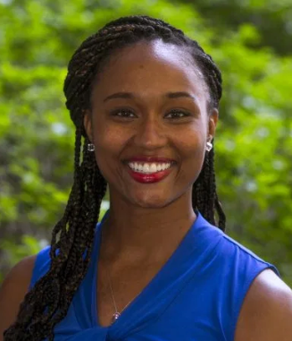
Case Study
MAPLE WALKER LLOYD
Director of Development & Community Engagement
Block Club Chicago
Notes:
Panel Discussion Points: Level of embeddedness
Central: BM is based on the mission like arts, childcare, revenue is directly tied to mission-based service provided
Complimentary: Do something, but side business which is related, but not explicit goal, generates income
Unrelated:
Have one example in the panel for each category.
Central – arts
Complimentary – San Jose, workforce development org with employment org on the side
Unrelated – FEGS – social service agency with back office accounting shop

Slide 29
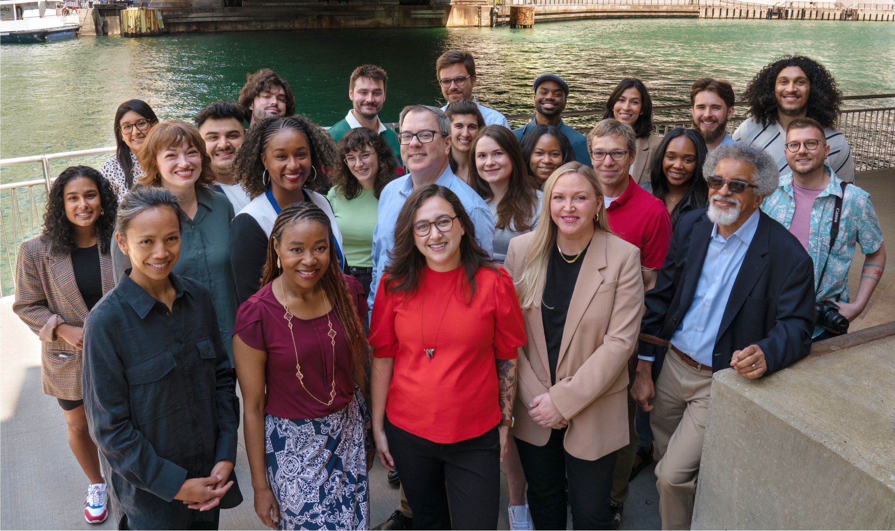

Slide 30
Our mission
Block Club Chicago is a nonprofit, nonpartisan news organization exclusively dedicated to delivering in-depth, original, daily coverage of Chicago’s diverse neighborhoods.
Our mission is to build community through quality, accurate reporting grounded in readers’ information needs. We aim to serve as a platform for community experiences, covering breaking news, investigative reporting, and feature stories that highlight the people, places, and events that make Chicago unique.
Block Club Chicago started in 2018 with 8 journalists, and has since grown to a newsroom of 29 experienced journalists who have a deep understanding of our city and its neighborhoods. Our award-winning coverage enabled us to transform from a scrappy startup to one of the most read news organizations in Chicago, publishing more than a dozen stories daily from every corner of our city. Our website is read by 1.5 million unique readers each month, and our free daily newsletter and hyperlocal neighborhood newsletters reach 130,000 Chicagoans.

Slide 31
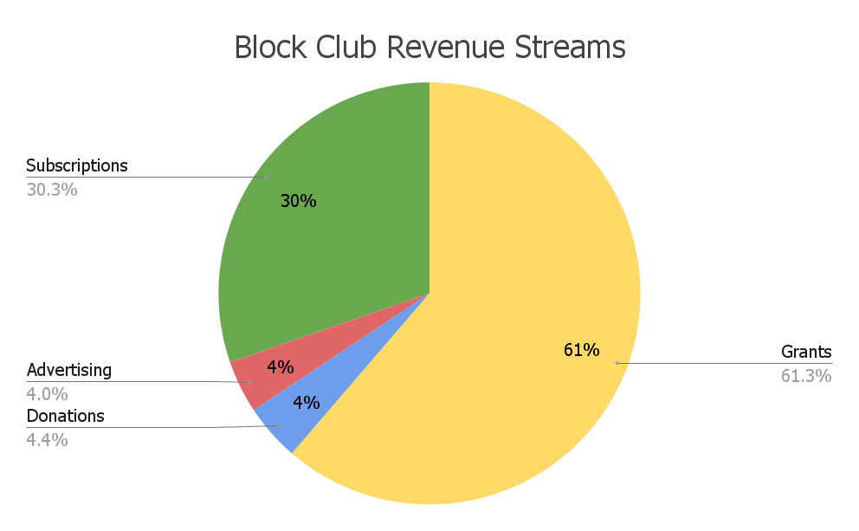
Current Revenue Streams

Slide 32
Value Proposition
You may think your value proposition ONLY benefits your supporters, but it also benefits YOU!
Funder/Investment should align with your mission and goals.
Don’t settle just because you need the money.
Know your worth!
1
2
3

Slide 33
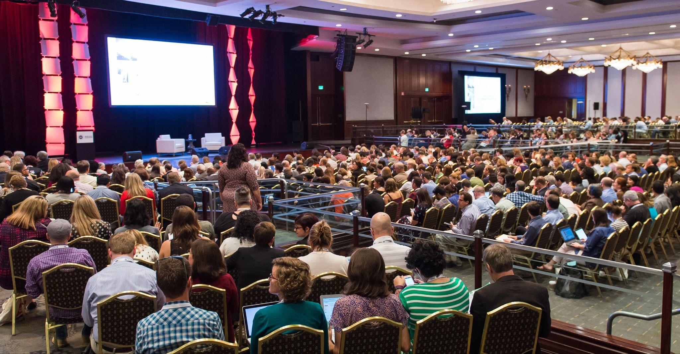
Network! Network!
Network
Funders want to put a face with the organization.
Ask within your network to make connections/introductions to foundations, especially when they don’t respond.
Remember, it’s more than just asking for money. Build and foster relationships.

Slide 34
Q&A

Slide 35
Resources & Wrap Up

Slide 36
Notes:
PRODUCER: Share Link - https://bit.ly/409L8Cx

Slide 37
Additional Sessions: Nonprofit Business Models
INDIVIDUAL DONOR: September 26th : 2-3:30pm ET
GOVERNMENT: Recording Available!
EARNED REVENUE: Recording Available!
MEMBERSHIP: November 28th : 2-3:30pm ET
Notes:
Shift to Hilda

Slide 38
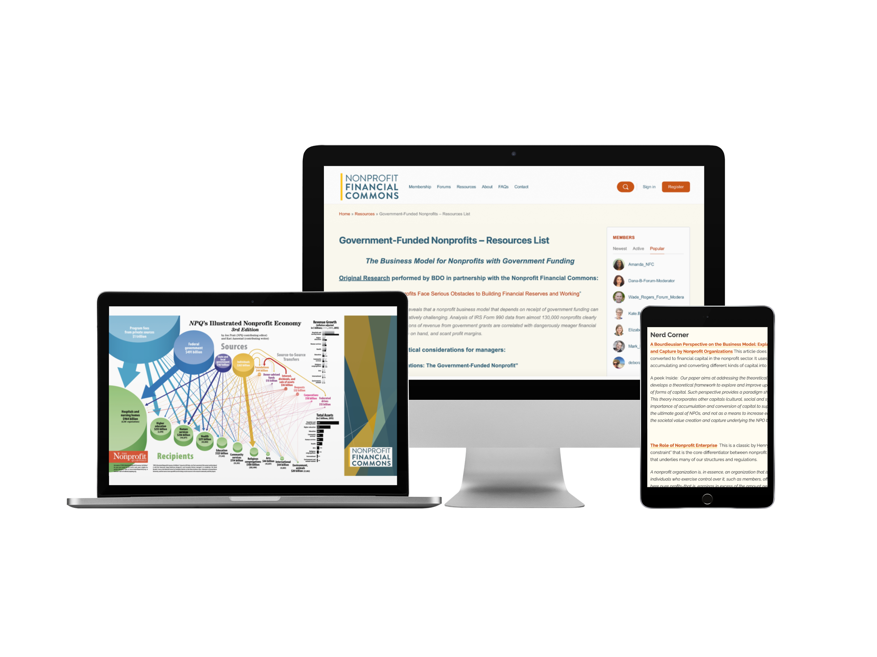

Slide 39
Stay Connected on the Forum
Notes:
Let’s keep the conversation going
A place to actively ask questions and receive answers
Kitchen table / stone soup
Share link to forum in the chat

Slide 40
What do you want to learn more about?
Add it to the chat!
Notes:
PRODUCER: Change chat settings to allow participants to use chat

