Slide 1
Revenue Recognition: A Nonprofit’s Guide to Recording Gifts and Grants
May 24, 2023

Slide 2
Enter your burning questions in the Chat, monitored by NFC moderators, to have them answered during our interactive Q&A sessions.
Wade Rogers
NFC Moderator
Dana Britto
NFC Moderator

Slide 3
Today’s Session
Today’s Presenter
Agenda
Gina McDonald, CPA
Managing Director, BDO
Overview - Revenue Categories and Key Features
Evaluating Revenue
Understanding Conditions and Restrictions
Putting it all together - examples
Q&A Throughout!

Slide 4
Poll: Select your most common revenue types. (select all that apply)
1 | Government grants
2 | Multi-year grants
3 | Matching grants
4 | Planned giving
5 | Purpose restricted

Slide 5
Poll: What challenges come up when evaluating revenue? (select all that apply)
1 | Determining proper timing to recognize revenue.
2 | Understanding if conditions exist.
3 | Understanding if restrictions exist.
4 | Determining when to release restrictions.
5 | Other.

Slide 6
Revenue Categories
Earned
Grants and Donations
Interest, Dividends, Gains/Losses
Contracts with Customers
Contributions
Investment Income

Slide 7
Key Revenue Features
Contracts with Customers
Contributions
Must have a resource provider (customer) who is the primary recipient of goods or services.
Presumes exchange of commensurate value.
Commonly referred to as “earned” or “exchange transaction”.
Resource provider (payor/funder) is not the recipient of goods or services.
Does not presume equal exchange of value.

Slide 8
Evaluating Revenue
Evaluate Transaction Substance
Identify Conditions
No customer buying for themselves. *
Identify Restrictions
Donor imposed barriers.
Donor imposed limitation on the use of funds.
Prohibit the recording of revenue/affect timing.
Considerations around method of delivery and determination of price or contract value.
Contributions indicate:
* Exception is third party payor arrangements or other similar arrangements for payments related to an already existing exchange transaction.

Slide 9
Questions?

Slide 10
What comes to mind when you hear “conditions” relative to revenue?

Slide 11
Understanding Conditions
Donor-imposed conditions are barriers coupled with a right of return or resource provider release from obligation.
Conditions affect ability to recognize revenue and related timing.
Common indicators (abstracted from FASB ASU 2018-08)
Remember UNCONDITIONAL contributions are recognized as revenue immediately.
Indicator | Example
Measurable performance related barrier | Requirement to meet milestone for installment payment; Matching
Stipulation that limits discretion | Allowability of only certain qualifying expenses or requiring specific protocol
Stipulation related to the purpose of the agreement | NOT stipulations unrelated to purpose of agreement, or trivial or administrative

Slide 12
Understanding Restrictions
Donor-imposed restrictions specify a contribution use for a purpose narrower than its broad mission and/or for a specific time period.
Restrictions cannot be self-imposed.
Restrictions can be temporary
Restrictions can be perpetual
Certain restrictions can be implied

Slide 13
Putting it all together
Satisfying restrictions
Satisfying conditions
Satisfying restrictions
Receive donor communication of contribution. Do conditions exist?
YES
Recognize revenue according to donor’s desired level of restriction
NO
Recognize revenue according to donor’s desired level of restriction

Slide 14
Putting it all together – additional details
If cash is received prior to satisfaction of conditions (cash received and revenue cannot yet be recognized) record as refundable advance (liability).
Do not perform probability analysis related to ability to satisfy conditions.
Some revenue may be part contribution and part exchange transaction.
May have a simultaneous satisfaction of condition and release from restriction.

Slide 15
Putting it all together – Example 1
FACTS:
Individual donor responds to capital campaign solicitation for contributions to renovate a nonprofit’s facility.
Donor indicates a $100,000 contribution with a 1:1 matching requirement.
A check for $25,000 accompanies the documentation and donor requests a quarterly report indicating progress towards match.
How and when will this contribution be recognized?

Slide 16
Putting it all together – Example 1
RESOLUTION:
Conditions exist
Matching requirement is a barrier coupled with an inability to collect/retain the funds if not satisfied.
Conditions can be satisfied in stages, if the donor permits.
$25,000 up front cash receipt is a refundable advance.
Restrictions exist
Contribution is restricted for the purpose of the capital campaign (facility renovation).
When revenue is recognized, indicate donor restriction. Release when entire renovation is complete and placed in service (not “as spent”).

Slide 17
Putting it all together – Example 2
FACTS:
Nonprofit is awarded State contract (Federal source) to provide after-school programs.
Contract has been determined to be a contribution based several factors, including the following:
Resource provider is not receiving direct commensurate value as a result of this contract.
Nonprofit must follow the rules established by the U.S. Office of Management and Budget, the Federal awarding agency and additional guidelines imposed by the State, including incurring qualifying expenses to entitled to the grant dollars.
Contract requires monthly invoices to the State and reimburses actual costs within limits of approved line-item budget.
Additional periodic programmatic reports are required.
How and when will this contribution be recognized?

Slide 18
Putting it all together – Example 2
RESOLUTION:
Conditions exist:
Stipulations in the contract limit discretion.
Conditions can be satisfied in stages as they are satisfied. In practice, when invoices are prepared monthly, revenue is recognized monthly.
Restrictions exist:
Contribution is restricted for after-school programs.
Simultaneous satisfaction of condition and release from restriction occurs as services are provided and dollars are spent. In practice, revenue is recorded as without donor restrictions.

Slide 19
Questions?

Slide 20
Resources & Wrap Up

Slide 21
Resources
https://www.bdo.com/insights/assurance/fasb-clarifies-and-improves-guidance-for-not-for-profit-grant-and-contributions-accounting
(includes a helpful flowchart – abstract to follow on next slide)
https://www.bdo.com/insights/blogs/nonprofit-standard/are-grants-subject-to-revenue-recognition
https://www.journalofaccountancy.com/issues/2017/mar/revenue-recognition-at-not-for-profits.html

Slide 22
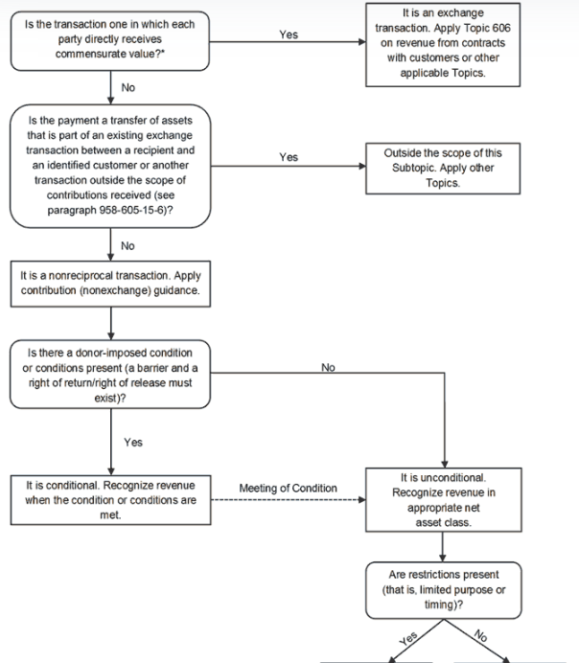
Click the link for full flowchart!
https://www.bdo.com/insights/assurance/fasb-clarifies-and-improves-guidance-for-not-for-profit-grant-and-contributions-accounting

Slide 23
What’s Next?
Additional questions and topics:
Recommendations on systems and tools for tracking restricted grants.
How to record evaluate and record in-kind contributions.
The best way to track contribution information related to donor-advised funds.
How to report grants, including conditional and restricted to the Board and other stakeholders in transparent and meaningful way.
Suggestions for cash basis tracking.
Stay tuned!

Slide 24
Stay Connected on the Forum

Slide 25
About BDO USA
At BDO, our purpose is helping people thrive, every day. Together, we are focused on delivering exceptional and sustainable outcomes — for our people, our clients and our communities. Across the U.S., and in over 160 countries through our global organization, BDO professionals provide assurance, tax and advisory services for a diverse range of clients.
BDO is the brand name for the BDO network and for each of the BDO Member Firms. BDO USA, LLP, a Delaware limited liability partnership, is the U.S. member of BDO International Limited, a UK company limited by guarantee, and forms part of the international BDO network of independent member firms.
www.bdo.com
Material discussed is meant to provide general information and should not be acted on without professional advice tailored to your needs.
© 2023 BDO USA, LLP. All rights reserved.

